Slide 1
Sales Dataset Analysis –Advanced Excel Project
Student’s Name: Megasree M
Date : 25-02-2025
Course & batch name information: Data Analytics and Data Science

Slide 2
Data Description and preparation
Dataset overview:
The dataset contain 9995 Rows and columns such as Order ID, Sales ID, Product Type ,etc.
Data Cleaning Process:
In the data cleaning , removed the duplicate in customer name, added column for month , day , year and quarters.

Slide 3
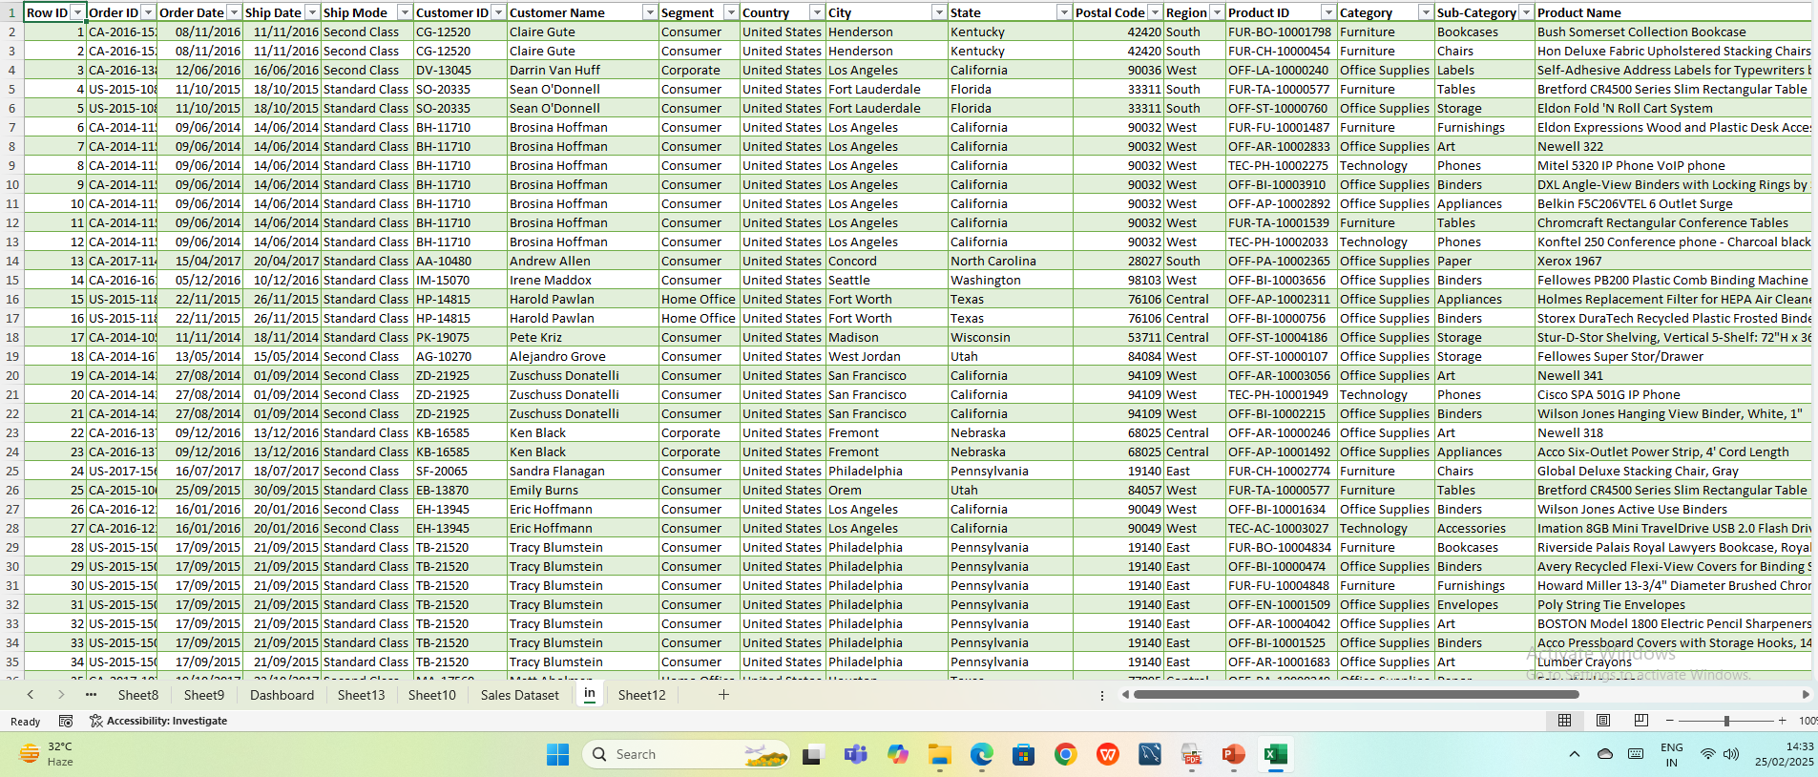
Before cleaning data

Slide 4
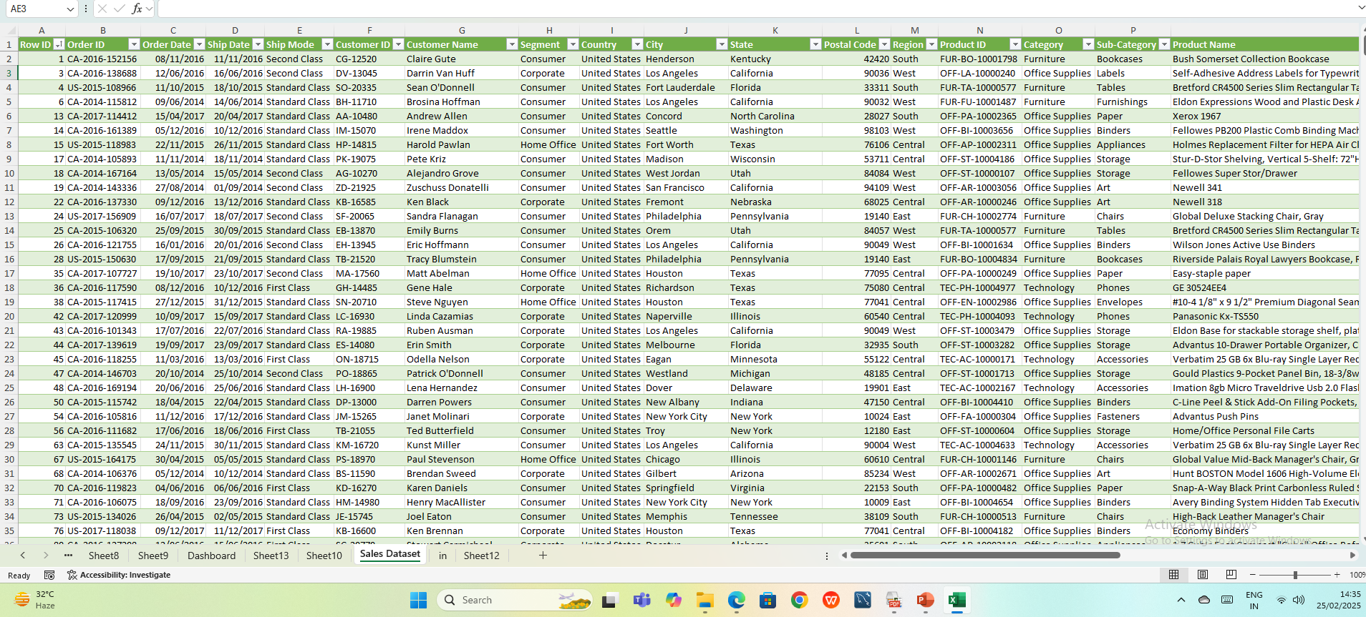
After cleaning data

Slide 5
Key Metrics Calculation and Data Analysis
In this Dataset applied a formula for the (countif ,outliers, adjusted sales)
Formula of countif =COUNTIF([Category],"Office supplies")
Formula of outliers =IF(ABS(T2)>3,"Yes","No") , Outliers applied for Sales and Discount.
Formula of adjusted sales =[@Sales]-[@Discount]

Slide 6
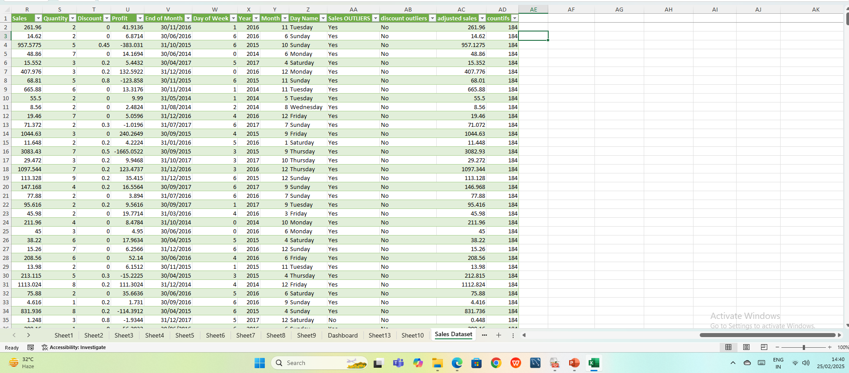

Slide 7
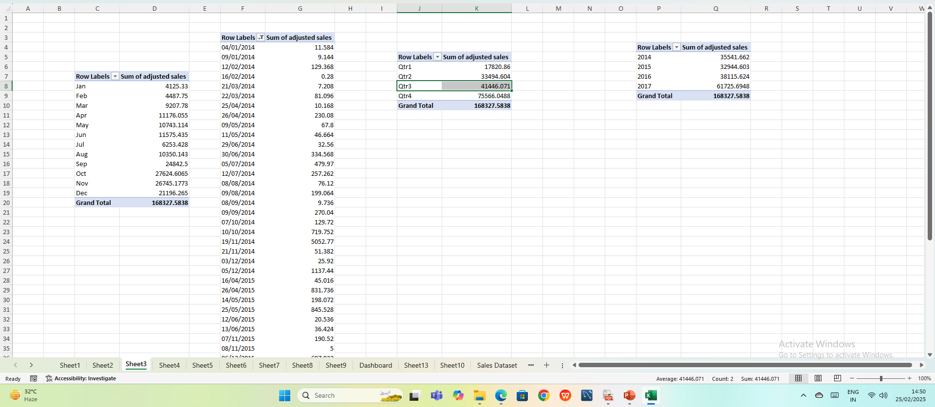
Pivot Table

Slide 8
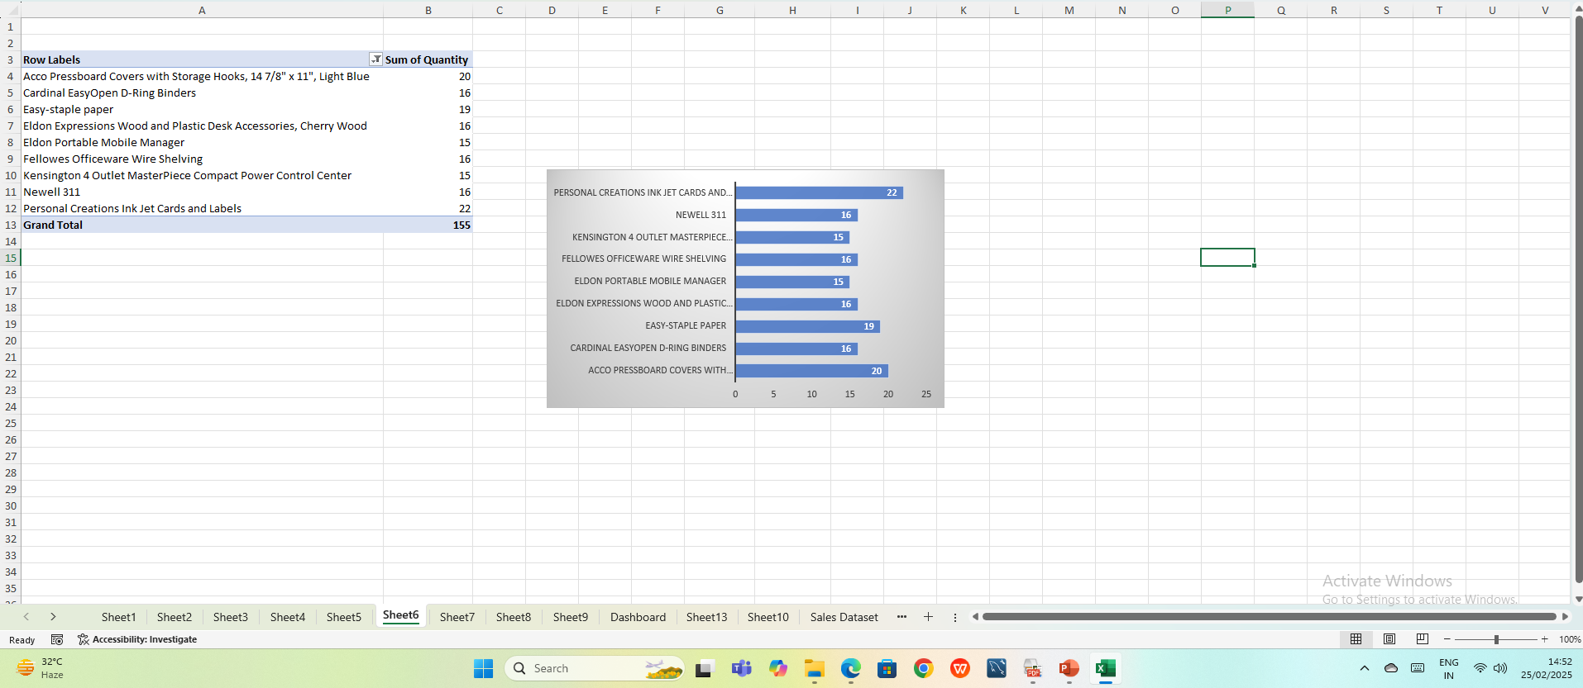
Pivot Charts

Slide 9
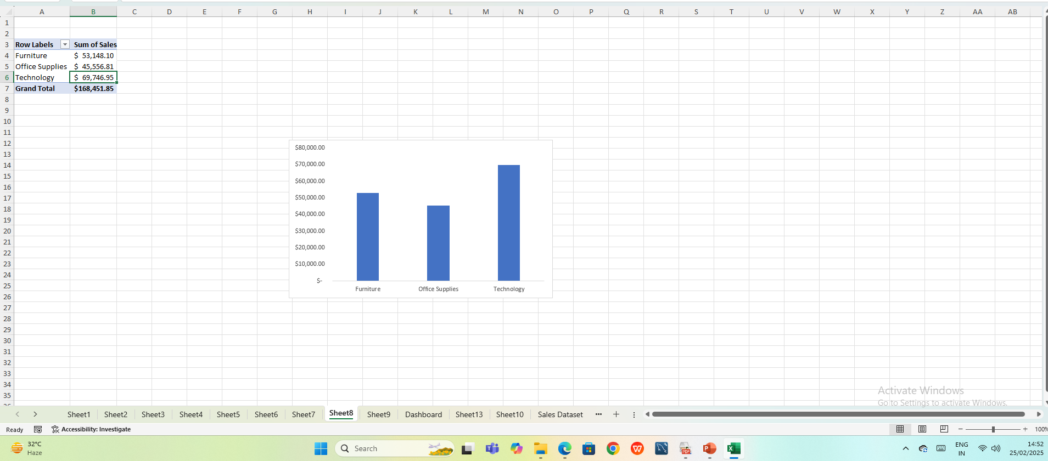

Slide 10
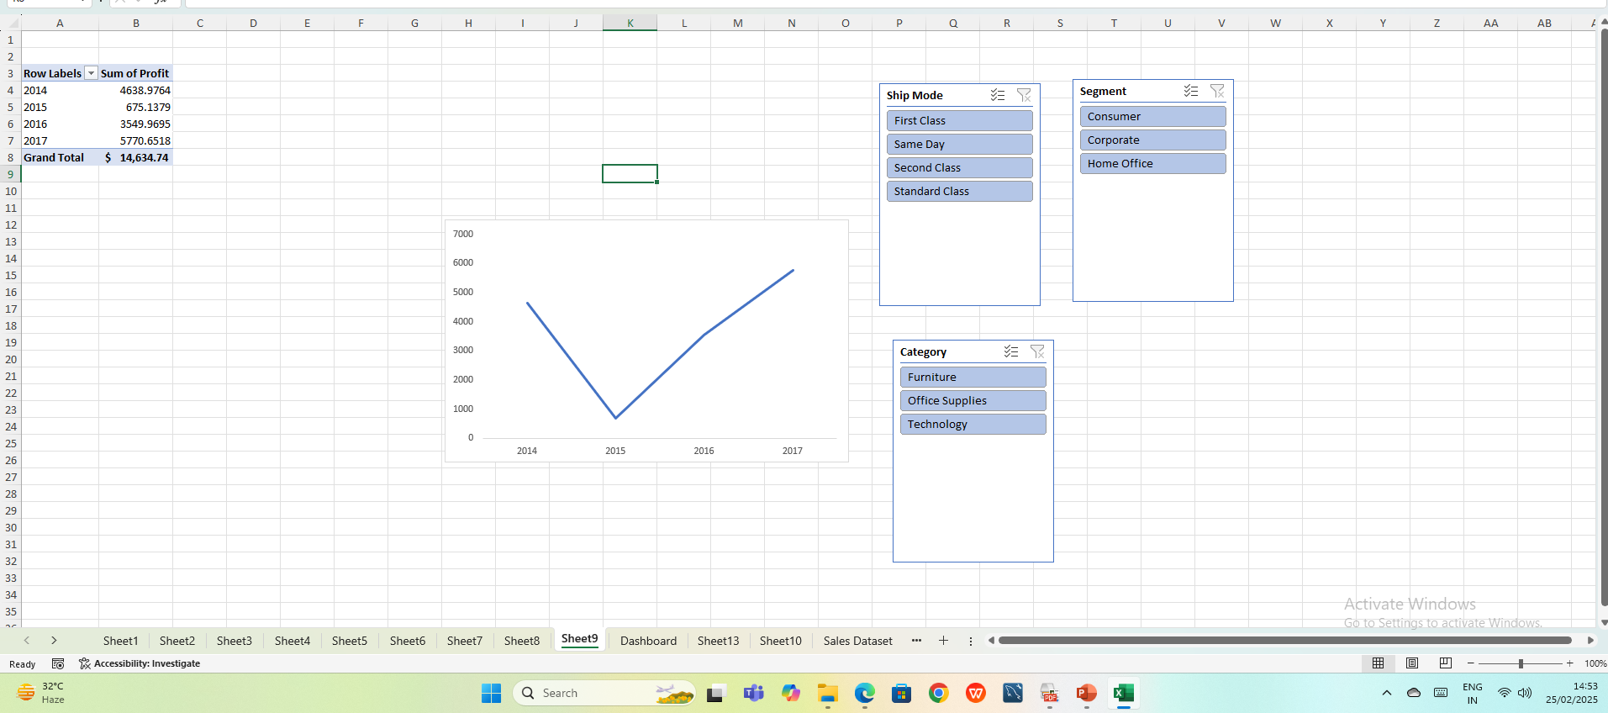

Slide 11
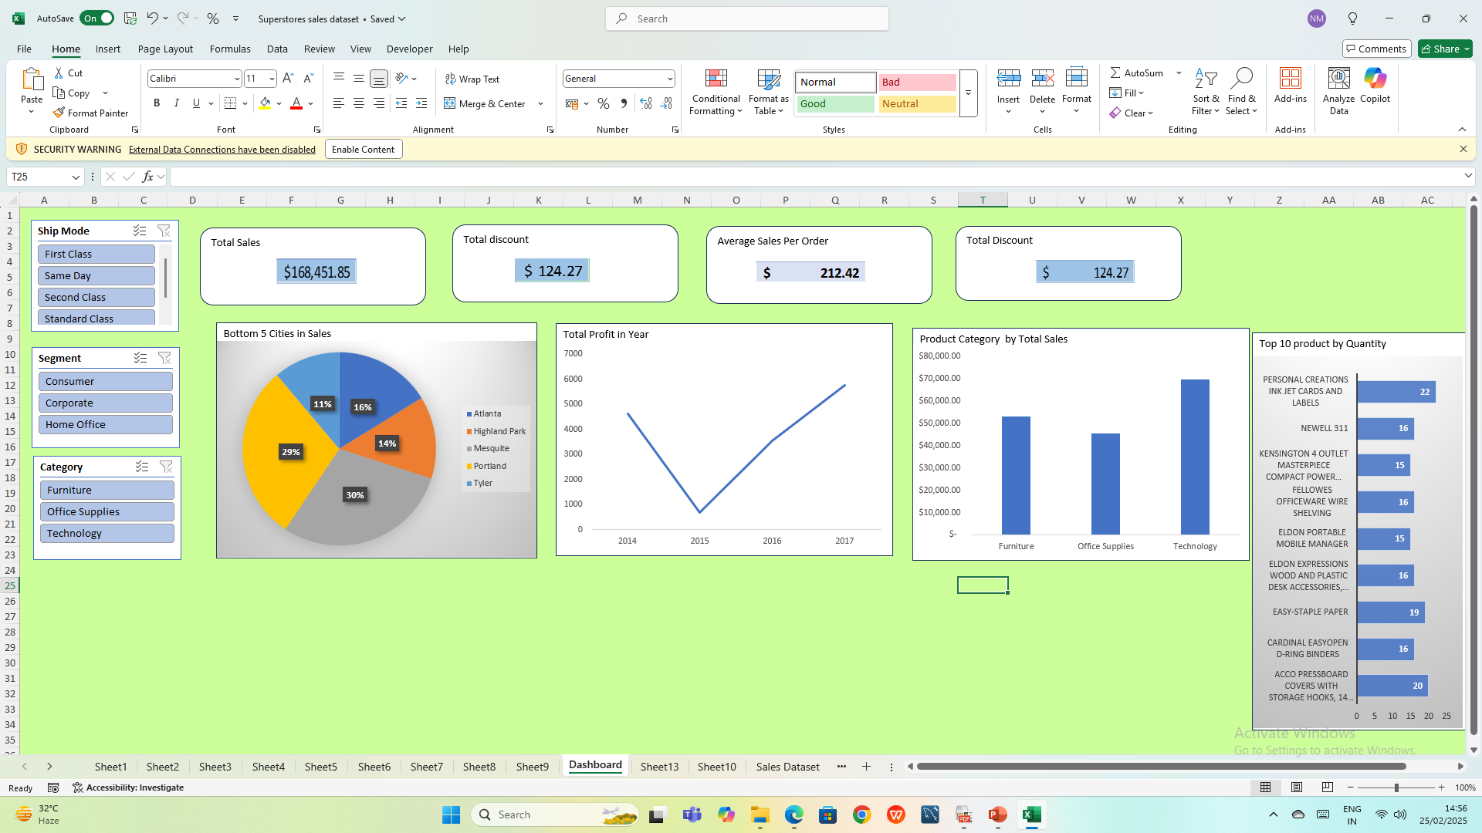
Dashboard overview

